Slide 1
THE COST OF DISRUPTION: ANALYZING THE IMPACT OF NEW TASKS ON TIME-EVOLVING COGNITIVE ACTIVITY
S. M. Gordon¹ & J. Touryan²
¹DCS Corporation
² US Army DEVCOM ARL
DISTRIBUTION STATEMENT A.
Approved for public release; distribution is unlimited. OPSEC # TDM-26-0987

Slide 2
Introduction
Problem statement: how can we ensure optimal human-system performance?

Slide 3
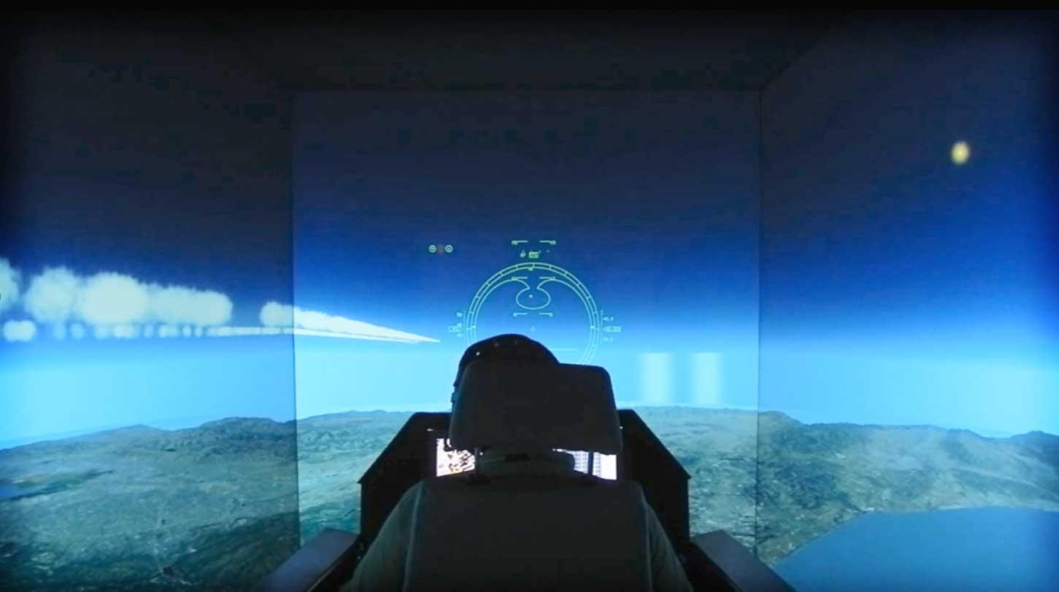
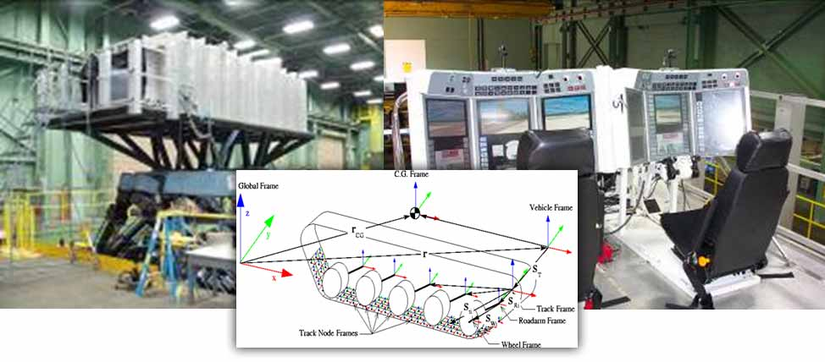
Introduction
How do we construct our models?
Static
Reactive
3
World
System
Human

Slide 4
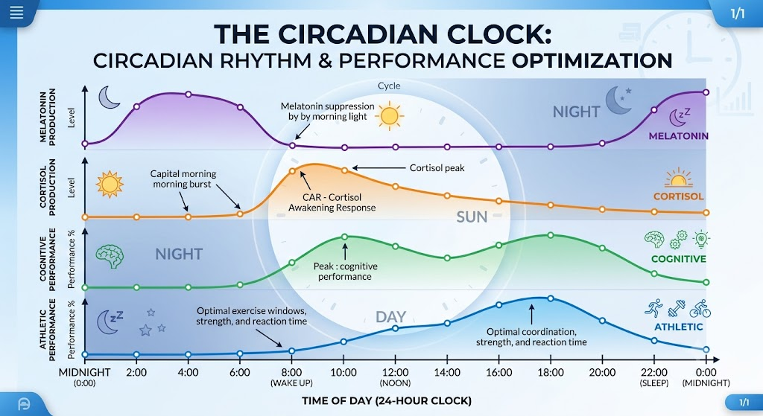
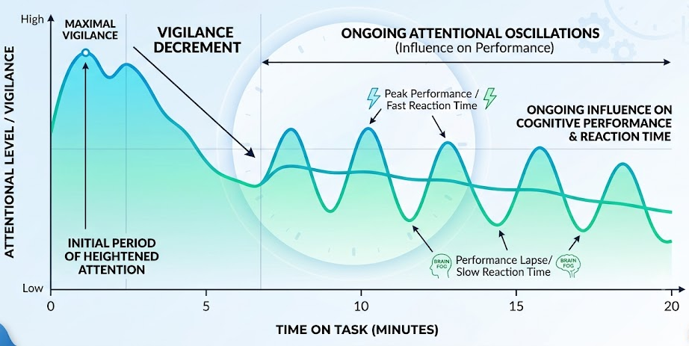
Introduction
A simple counter example: Circadian rhythm
*Valdez, P., Ramírez, C. and García, A., 2012. Circadian rhythms in cognitive performance: implications for neuropsychological assessment. Chronophysiology and therapy, pp.81-92.
*Schmidt, C., Collette, F., Cajochen, C. and Peigneux, P., 2007. A time to think: circadian rhythms in human cognition. Cognitive neuropsychology, 24(7).
*Thun, E., Bjorvatn, B., Flo, E., Harris, A. and Pallesen, S., 2015. Sleep, circadian rhythms, and athletic performance. Sleep medicine reviews, 23, pp.1-9
Notes:
All of the components are complex
System is at least understood (or understandable)
World is often modeled as stochastic (at least over long time scales), which presents a problem
Limits the human to modeled as stim-response

Slide 5
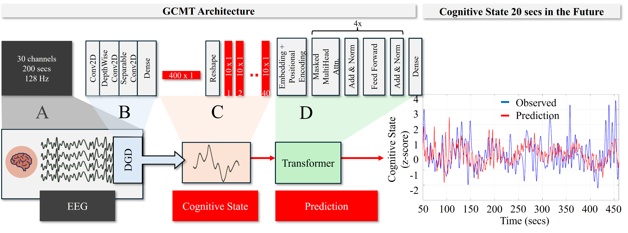
Generative Cognitive Modeling Tool
Our team constructed the GCMT to model and predict changes in latent cognitive state over timescales associated with individual operational tasks
State is derived from physiology (EEG)

Slide 6
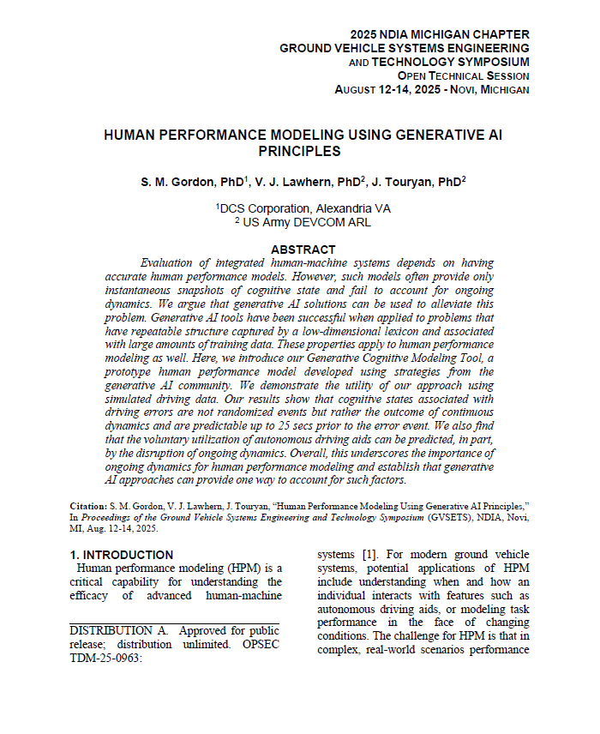
Motivation
Prior work had shown:
1. Vehicle driving errors could be attributed to ongoing dynamics
2. Error signal b/n predicted state and observed state correlated with driver handoffs autonomous driver

Slide 7
Using the Model
Developed the model
Validated the model
Based on the model…
… evidence suggests that the human “system” does not like being disrupted
Notes:
To be very clear… disturbed does *not* mean given a task… it means having the underlying dynamics disrupted. Similar to be awoken to deal with an email.

Slide 8
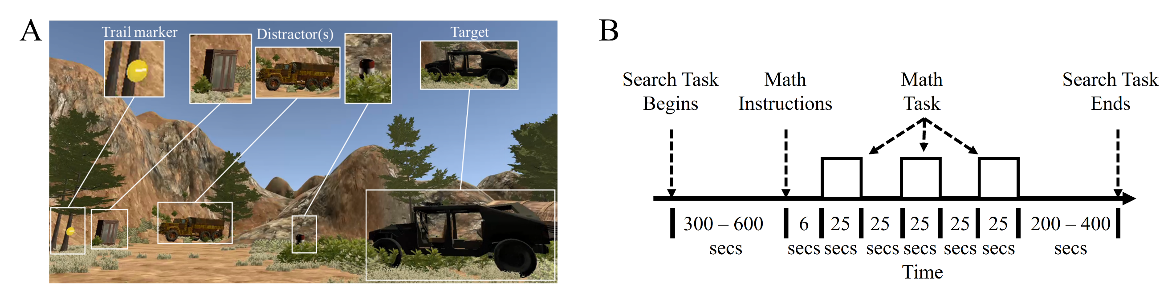
New Test Data
66 Total Participants:
45 participants from greater Los Angeles area
(17 female, mean age 36.8 ± 12.3, 28 male mean age 41.6 ± 14.4)
21 participants from Joint Base San Antonio
(3 female, mean age 43.7 ± 6.7, 18 male mean age 32.6 ± 7.9)
Task was to navigate through simulated environment and search for visual targets
5-10 minutes into task (randomly decided) a side task appears… add a bunch of numbers
Recorded:
EEG
Eye movement
Blink rate
Pupillometry

Slide 9

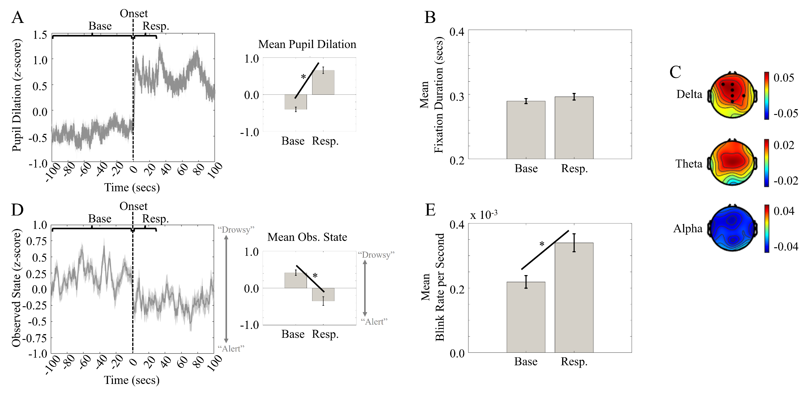
Analysis #1 – Basic Response
Across the group, what happens when the math task arrives?
Looks like a stress response

Slide 10
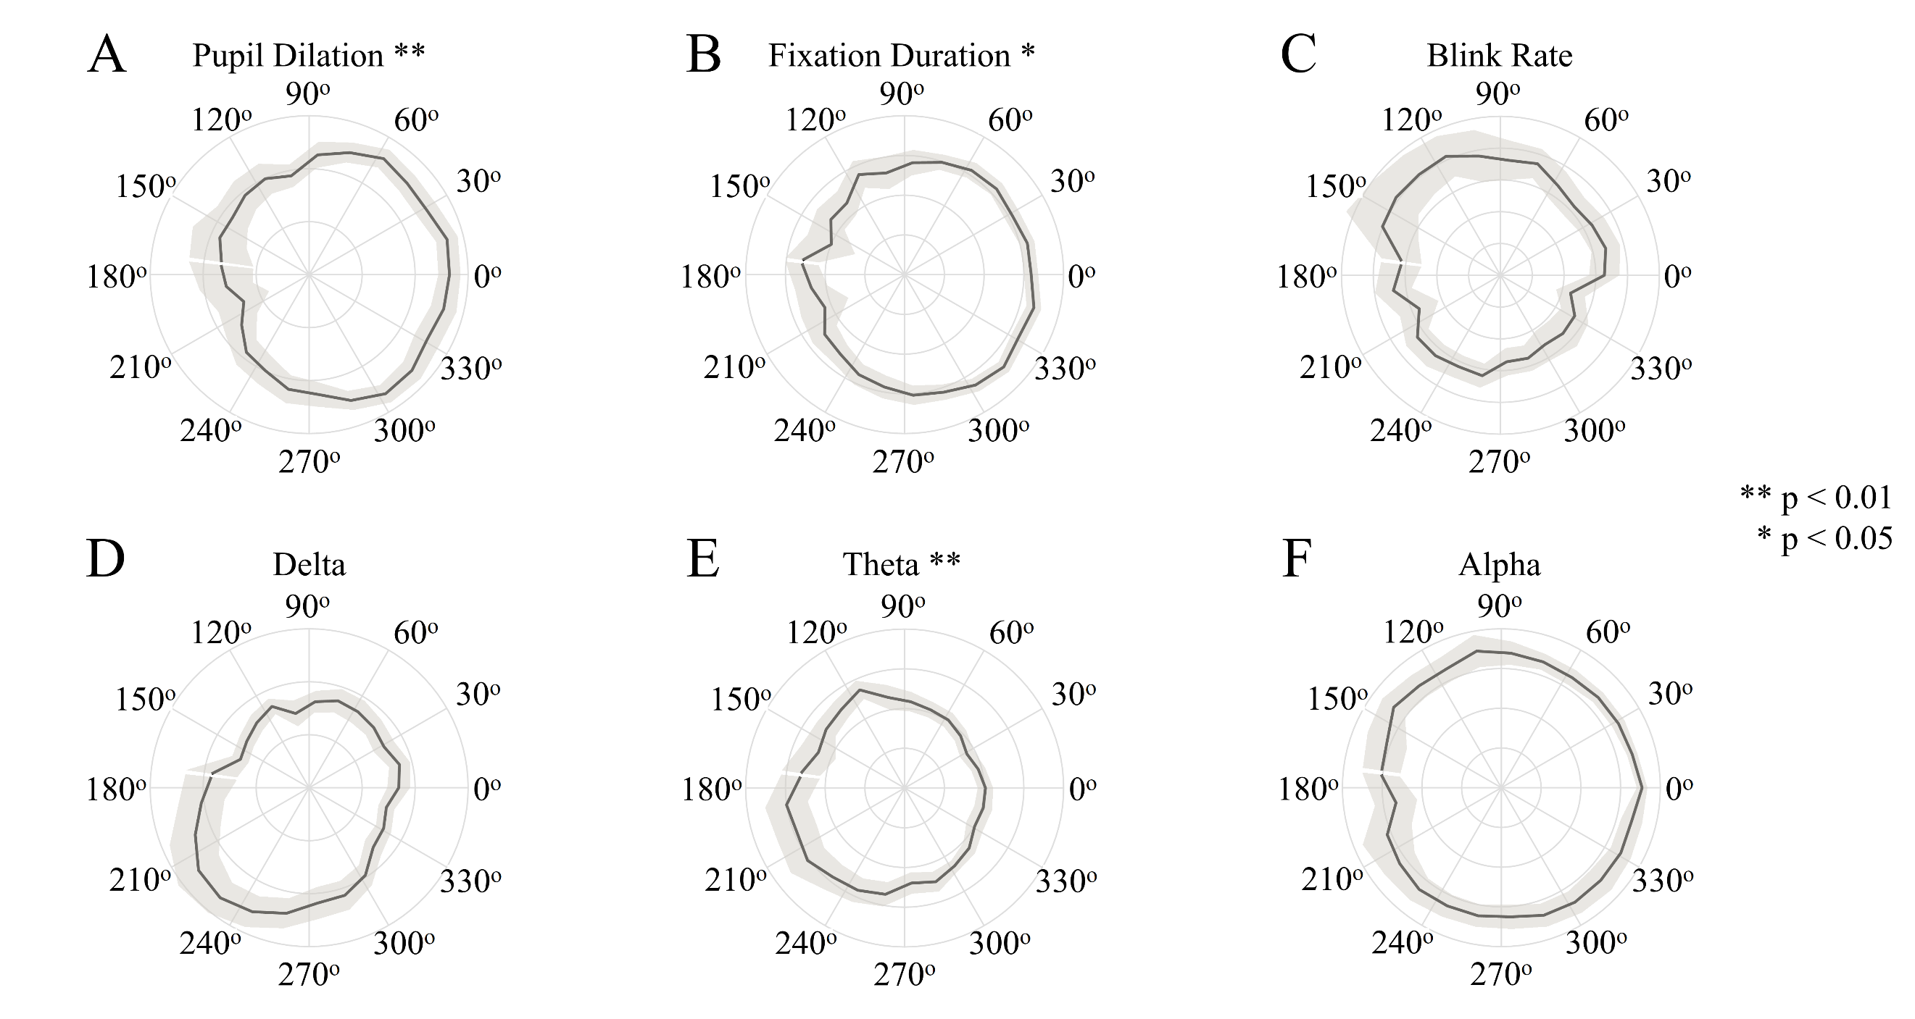
Analysis #2 – Response as Func(Dynamics)
Computed phase (rising/falling) of predicted state at the time of task onset
~0º phase

Slide 11
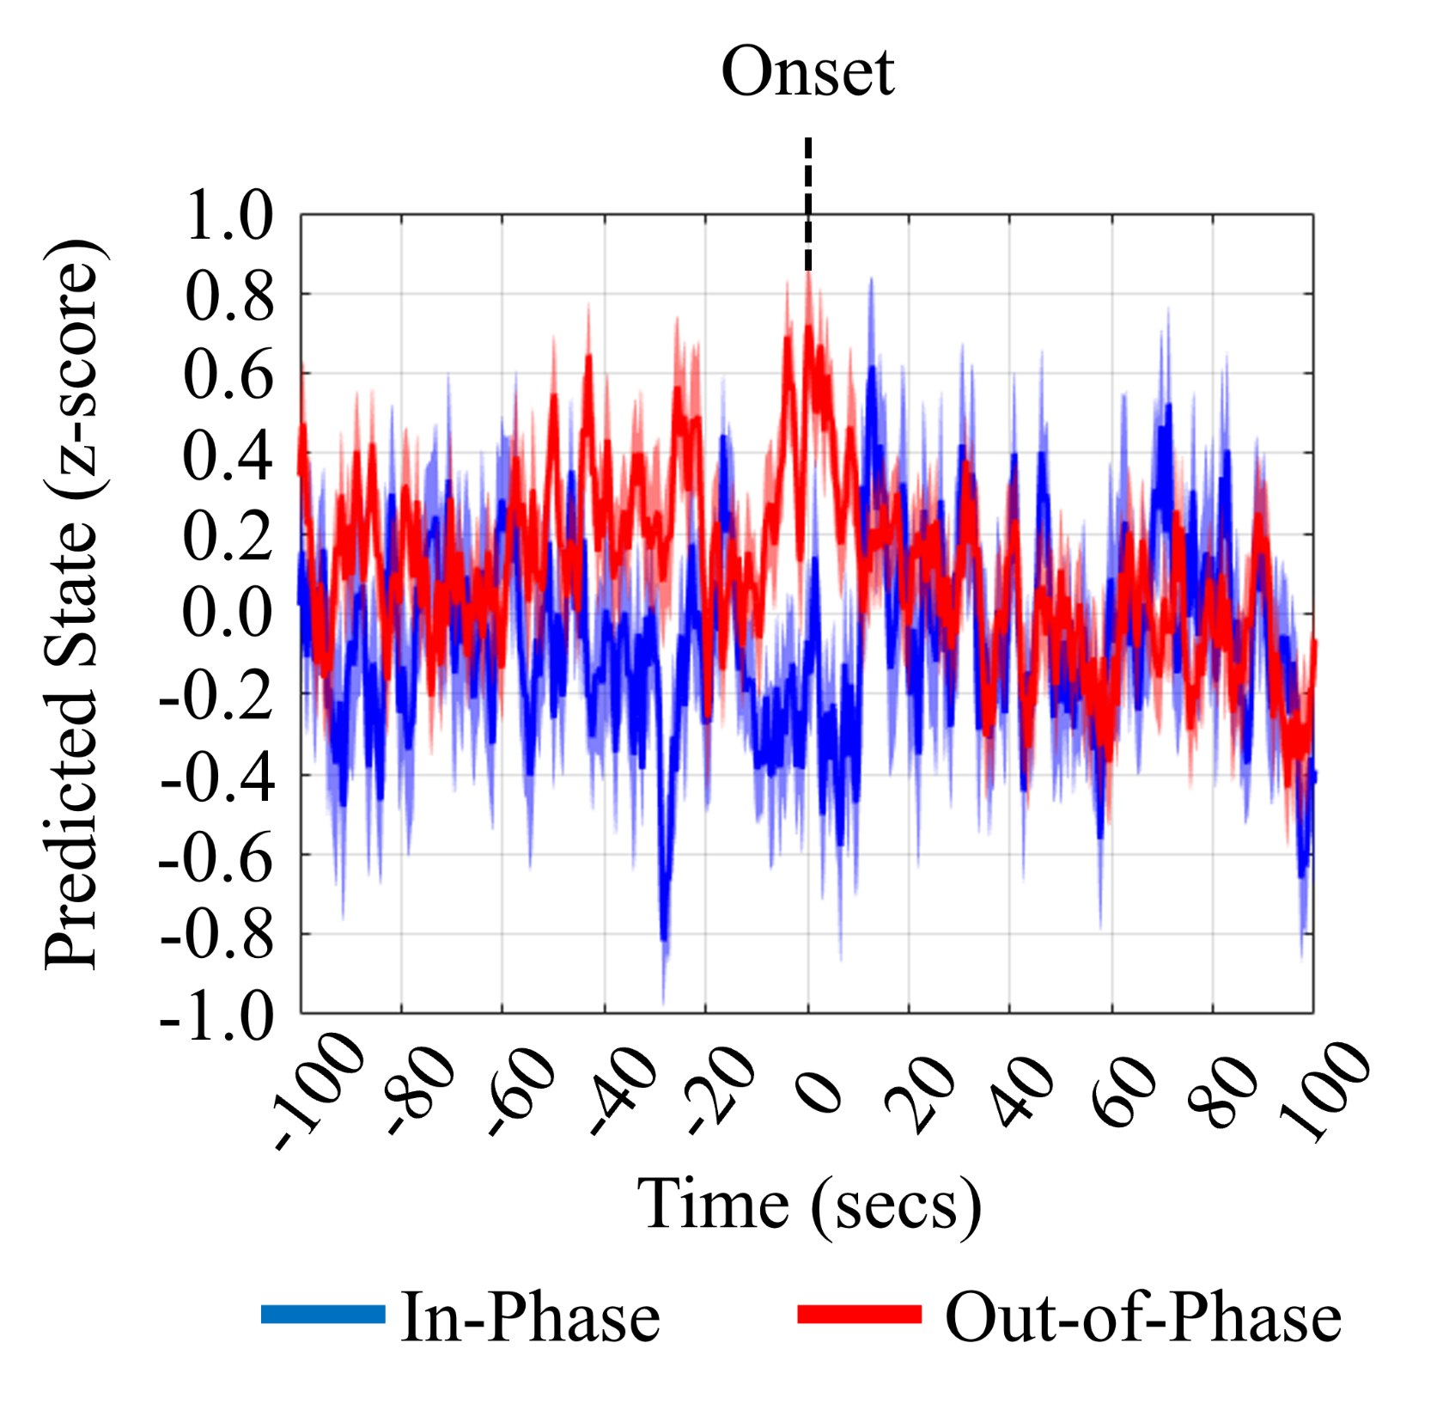
Analysis #3 – Impact of Onset Time
Using observed response (~0º) as reference point, we split the participants into two groups
“in-phase” was ± 90º of reference point (blue)
“out-of-phase” was > 90º from reference point (red)

Slide 12
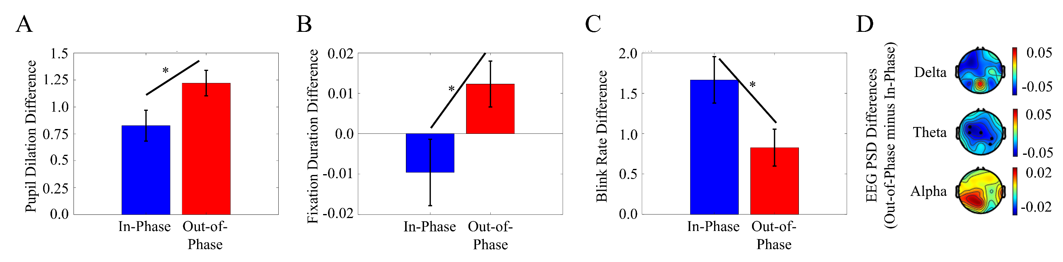
Analysis #3 Cont’d
“Out-of-phase” group
Significant changes in pupil dilation, fixation duration, and blink rate relative to “in-phase”
    Moves from “stress response” → “increased cognitive load”
Notes:
Also had < frontal theta (contrary to increased workload measure)
… but recall “in-phase” group got Theta for “free”

Slide 13
Discussion
Time and ongoing dynamics matter
Disrupting the dynamics led to apparent increase in “cognitive load”
This provides partial explanation for why drivers offload tasking in prior study
We can model these dynamics
Using the group model → simulate responses and temporal effects

Slide 14
Discussion
Solution statement: Ensuring optimal human-system performance requires modeling and incorporating dynamics of the human system as well*

Slide 15
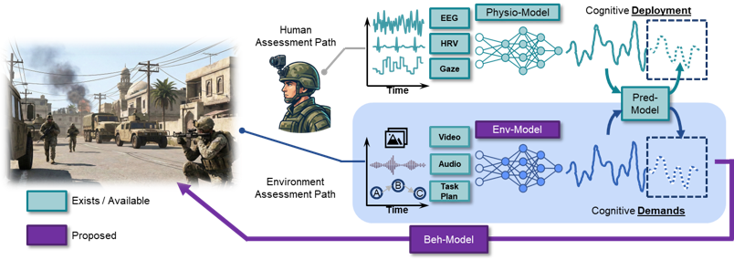

Conclusion
So, what’s next?
Near Term: Refining & expanding the GCMT
Ultimate goal: Full-scale digital twin (blue) of human cognition
Thank you for your time
Questions:
Stephen Gordon, PhD
sgordon@dcscorp.com
DCS Corporation

